Slide 1
Human-Robot Interaction & Evolutionary Robotics :
Summary
by Dr. Katrin S. Lohan
*Multiple slides over the course adapted form joint work with colleagues.

Slide 2
What is human-robot interaction?
Human–robot interaction is the study of interactions between humans and robots. It is often referred as HRI by researchers.
Human–robot interaction is a multidisciplinary field with contributions from human–computer interaction, artificial intelligence, robotics, natural language understanding, design, neuroscience, social sciences, biology …

Slide 3
How can we study HRI?
by implementing theories about how humans e.g. how they learn:
verify them through controlled HRI studies
explore the system through explorative studies
make a proof of concept by achieving a learning outcome

Slide 4
Study Design
How are we going to evaluate the interaction?
Hypothesis
What do you want to find out?
Population
Who?
Task
How do the participants interact with the robot?
Setup
What equipment is involved and how?/ How is the environment structures in your study?
Metrics
How will you measure?

Slide 5
Population/Participants
The people going through your study
Type - Two general approaches
Have lots of people from the general public
Results are generalisable
Logistically difficult
People will always surprise you with their variance
Select a niche population
Results more constrained
Lower variance
Logistically easier
Number
The more, the better
How many is enough?
Logistics
Recruiting (n>20 is pretty good)

Slide 6
Design
External validity – do your results mean anything?
Results should be similar to other similar studies
Use accepted questionnaires, methods
Power – how much meaning do your results have?
The more people the more you can say that the participants are a sample of the population
Pilot your study
Generalisation – how much do your results apply to the true state of things

Slide 7
Task
Identify the task that your participants will fulfil during a session of your experiment
E.g. explain how to stack-cups
Some times it is not so straight forward!

Slide 8
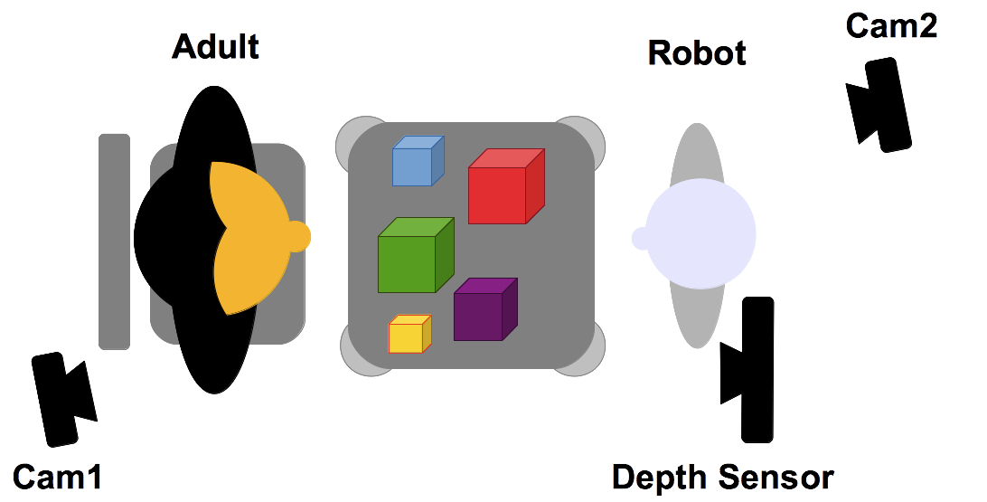
Setup
Describe the equipment you will use in your experiment
technical details
other important features (e.g. size, colour, shape, usability, …)
Describe the space you are using
Use figures or pictures to show the setup:

Slide 9
Design
Participants using language to explain how to stack-cups to a robot will take less time than participants using only gestures.
Let’s create a study design
Hypothesis
Population
Task
Setup
Two types:
Between Subjects
Across Subjects

Slide 10
Procedure
Formally have all participants sign up for a time slot (if individual testing is needed)
Informed Consent
Execute study
Questionnaires/Debriefing

Slide 11
Metrics
What you are measuring
Types of metrics
Objective
Time to complete task
Errors
Ordinal/Continuous
Subjective
Satisfaction
Pros/Cons of each type?

Slide 12
Embodiment in Interaction
The following definition, developed by Quick et al., 1999a, Quick et al., 1999b),is defining embodiment as that which establishes a basis for structural coupling by creating the potential for mutual perturbation between system and environment. Embodiment is in this sense not solely a feature of a system in an environment, but is grounded in the relationship between the two.
Definition: A system S is embodied in an environment E if perturbatory channels exist between the two. That is, S is embodied in E if for every time t at which both S and E exist, some subset of E’s possible states with respect to S have the capacity to perturb S’s state, and some subset of S’s possible states with respect to E have the capacity to perturb E’s state.

Slide 13
Embodiment in Interaction
How can we manipulate this embodiment ?
by manipulating the system
the environment
how they interact with each other
a combination of the above
How does it effects the interaction?
let’s find out what happens when we manipulate the system

Slide 14

Embodiment Experiment
Notes:
compared iCub eyes only, head and baby-face condition
saliency system

Slide 15
Summary: Embodiment in Interaction
an example
The degrees of freedom have been manipulated and therefore the system.
The appearance has been manipulated and therefore the embodiment.
Notes:
to summerize
hand trajectories dose not reveal a difference
eye-gazing dose
embodiment helps to support the acceptance of the robot as a social interaction partner
also supported by the language
but the complexity of language is more appropriate less complex?

Slide 16
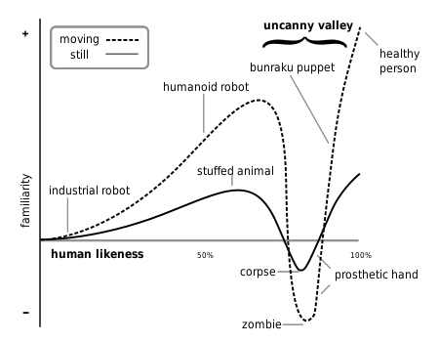
The Uncanny Valley
Mori, M. (1970/2012). The uncanny valley (K. F. MacDorman & N. Kageki, Trans.). IEEE Robotics & Automation Magazine, 19(2), 98–100.

Slide 17
Attention
Attention is the behavioural and cognitive process of selectively concentrating on a discrete aspect of information, whether deemed subjective or objective, while ignoring other perceivable information.
Attention has also been referred to as the allocation of limited processing resources.

Slide 18
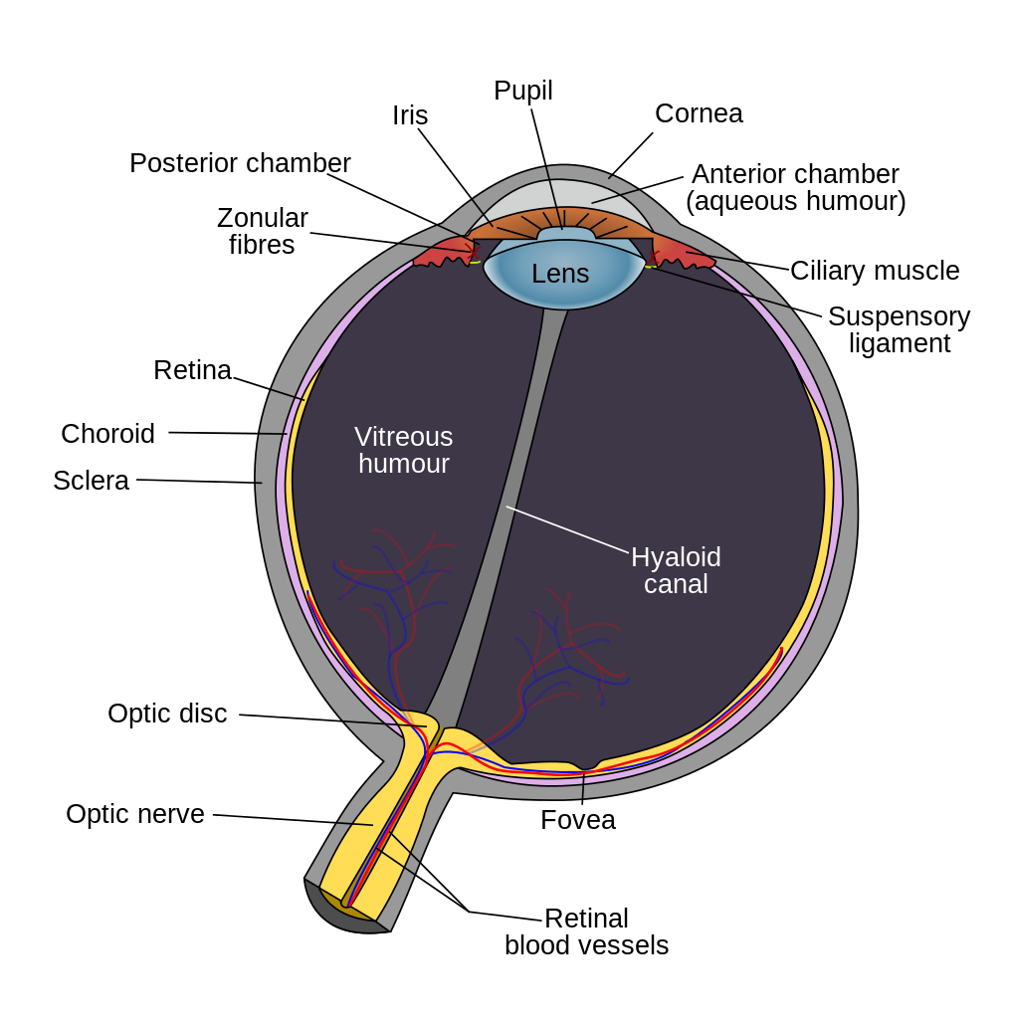
Visual Attention
Defined by Cognitive Phycology
Visual attention a two-stage process [1]:
attention is distributed uniformly over the external visual scene
attention is concentrated to a specific area of the visual scene (i.e. it is focused)
This focusing process can be explained by the Fovea
small central pit composed of closely packed cones
fovea is responsible for sharp central vision (also called foveal vision)

Slide 19
Existing Approaches: Saliency Systems
Multiscale image analysis
Entropy
Self-Similarity
Center-Surround approach
Distance transform
Global Contrast
Symmetry
Local steering kernels
Graphical model

Slide 20
Summary: Saliency systems
For robotics applications use a light weight methods like Mean or Random contrast based saliency
Graph and Multiscale saliency are ideal for psychological experiment modelling
O(Mean) < O(Random) < O(Multiscale) < O(Graph)

Slide 21

Audio Attention
Selective auditory attention
The cocktail party effect [1]:
The sounds and noise in the surrounding environment is heard by the auditory system but certain parts of the auditory information are processed in the brain only.
Sound localisation:
ability to identify the location or origin of a detected sound in direction and distance
http://youtu.be/JJoPLrqdzSc

Slide 22
Joint Attention
Joint attention is the shared focus of two individuals on an object
In human robot interaction joint attention is important to create and sustain the interaction [3]

Slide 23
Levels of Joint Attention
We can define different three levels of joint attention:
triadic, dyadic, and shared gaze.
Triadic joint attention: involves two individuals looking at an object
Dyadic joint attention: is a conversation-like behaviour, e.g. adults and infants take turns
Shared gaze: two individuals are looking at the same object

Slide 24
Turn Taking
refers to the process by which people in a conversation decide who is to speak next
is a part of the structure and systematic organisation of conversation
gazing behaviour plays a important role in turn-taking mechanisms:
mutual-break: is when there is a pause in the conversation and both participants use a momentary break with mutual gaze toward each other and then breaking the gaze, then continuing conversation again
mutual-hold: is when the speaker also takes a pause in the conversation with mutual gaze, but then still holds the gaze as he/she starts to speak again

Slide 25
Evolution in the real world
Charles Darwin (1809–1882) formulated the scientific theory of evolution by natural selection, published in his book On the Origin of Species (1859).
Evolution by natural selection is a process first demonstrated by the observation that often more offspring are produced than can possibly survive.
This is followed by three observable facts about living organisms:
1) traits vary among individuals with respect to morphology, physiology, and behaviour (phenotypic variation),
2) different traits confer different rates of survival and reproduction (differential fitness), and
3) traits can be passed from generation to generation (heritability of fitness).
A collection of aspects

Slide 26
Evolution in the real world
Each cell of a living thing contains chromosomes (strings of DNA).
Each chromosome contains a set of genes (blocks of DNA).
Each gene determines some aspect of the organism (hair color).
A collection of genes is called a genotype.
A collection of aspects is called a phenotype.

Slide 27
Evolution in the real world
Reproduction involves recombination of genes from parents and then small amounts of mutation (errors) in copying.
The fitness of an organism is how much it can reproduce before it dies.
Evolution is based on survival of the fittest.

Slide 28
Evolutionary robotics (ER)
ER is a methodology that uses evolutionary computation to develop controllers for autonomous robots.
Algorithms in ER frequently operate on populations of candidate controllers, initially selected from some distribution.
This population is then repeatedly modified according to a fitness function.
In the case of genetic algorithms (or "GAs"), a common method in evolutionary computation, the population of candidate controllers is repeatedly grown according to crossover, mutation and other GA operators and then culled according to the fitness function.

Slide 29
Evolutionary game theory
Classical game theory: Game theory is "the study of mathematical models of conflict and cooperation between intelligent rational decision-makers".
Originally, it addressed zero-sum games, in which one person's gains result in losses for the other participants.
Game theory applies to a wide range of behavioural relations, and is an umbrella term for the science of logical decision making in humans, animals, and computers.

Slide 30
Evolutionary game theory
Evolutionary game theory started with the problem of how to explain ritualised animal behaviour in a conflict situation; "why are animals so 'gentlemanly or ladylike' in contests for resources?"
The leading ethologists Niko Tinbergen and Konrad Lorenz proposed that such behaviour exists for the benefit of the species.
John Maynard Smith considered that incompatible with Darwinian thought, where selection occurs at an individual level, so self-interest is rewarded while seeking the common good is not.

Slide 31
Evolutionary game theory
Maynard Smith realised that an evolutionary version of game theory does not require players to act rationally – only that they have a strategy. The results of a game shows how good that strategy was, just as evolution tests alternative strategies for the ability to survive and reproduce.
In biology, strategies are genetically inherited traits that control an individual's action, analogous with computer programs.
The success of a strategy is determined by how good the strategy is in the presence of competing strategies (including itself), and of the frequency with which those strategies are used. Maynard Smith described his work in his book Evolution and the Theory of Games.

Slide 32
Evolutionary game theory
Evolutionary game theory analyses Darwinian mechanisms with a system model with three main components – Population, Game, and Replicator Dynamics. The system process has four phases:
1) The model (as evolution itself) deals with a Population (Pn). The population will exhibit Variation among Competing individuals. In the model this competition is represented by the Game.
2) The Game tests the strategies of the individuals under the “rules of the game”. These rules produce different payoffs – in units of Fitness (the production rate of offspring). The contesting individuals meet in pairwise contests with others, normally in a highly mixed distribution of the population. The mix of strategies in the population affects the payoff results by altering the odds that any individual may meet up in contests with various strategies. The individuals leave the game pairwise contest with a resulting fitness determined by the contest outcome, represented in a Payoff Matrix.
3) Based on this resulting fitness each member of the population then undergoes replication or culling determined by the exact mathematics of the Replicator Dynamics Process. This overall process then produces a New Generation P(n+1). Each surviving individual now has a new fitness level determined by the game result.
4) The new generation then takes the place of the previous one and the cycle repeats. The population mix may converge to an Evolutionary Stable State that cannot be invaded by any mutant strategy.

Slide 33
Genetic Algorithms

Slide 34
Genetic Algorithms
How do you encode a solution?
This depends on the Problem.
GA’s often encode solutions as fixed length bid-strings
Each bit represents some aspect of the proposed solution to the problem
For GA’s to work, we need to be able to test any string and get a score indicating how good the solution is.

Slide 35
Genetic Algorithms
The set of all possible solutions [0.. 1000] is called the search space or state space.
It could be just one number from inside the above interval.
GA’s often use binary encoding in the bit-string, thus a solution is represented by one bit-string
If we select 1,0 bits we have enough to represent all numbers in the interval [0..1000].

Slide 36
Genetic Algorithms
Binary representation
1000 1011 0110 1111 P1 P2 P3 P4
Example: encoding 4 parameters:
Parameter P1 value = 1000 = 8 Parameter P2 value = 1011 = 11
{
{
{
{

Slide 37
Genetic Algorithms
Search Space
For a simple function f(x) the search space is one dimensional.
But by encoding serval values into the chromosome many dimensions can be searched e.g. two dimensions f(x,y).
Search space can be visualised as a surface or fitness landscape in which fitness dictates height.
Each possible genotype is a point in space.
A GA tries to move the points to better places (higher fitness) in the space.

Slide 38
Genetic Algorithms
Implicit fitness function
Most GA’s use explicit and static fitness functions
Some GA’s (such as Artificial Life or ER) use dynamic and implicit fitness functions- like “how many obstacles did I avoid”
Individual’s fitness
Average fitness of population

Slide 39
GA example
Offspring
Crossover point
Given a set of 5 genes, each gene can hold one of the binary values 0 and 1.
The fitness value is calculated as the number of 1s present in the genome. If there are five 1s, then it is having maximum fitness. If there are no 1s, then if has the minimum fitness.
This genetic algorithm tries to maximize the fitness function to provide a population consisting of the fittest individual.
Note: In this example, after crossover and mutation, the least fit individual is replaced from the new fittest offspring.
Tutorial: http://www.theprojectspot.com/tutorial-post/creating-a-genetic-algorithm-for-beginners/3

